Slide 1
Green Energy and Climate Modeling

Slide 2

Global Warming :
Understanding the forecast
David Archer
Simulate the future on your desktop
Climate Modeling
Renewable energy sources and conversion technology,
Bansal, Keemann, Meliss,
Renewable energy resources and emerging technologies
Kothari D.P.,
Science, Statistics,
Parameterization, Results
It’s all in here!
A. Gettelman& J. Hack
Real NCAR Scientists

Slide 3
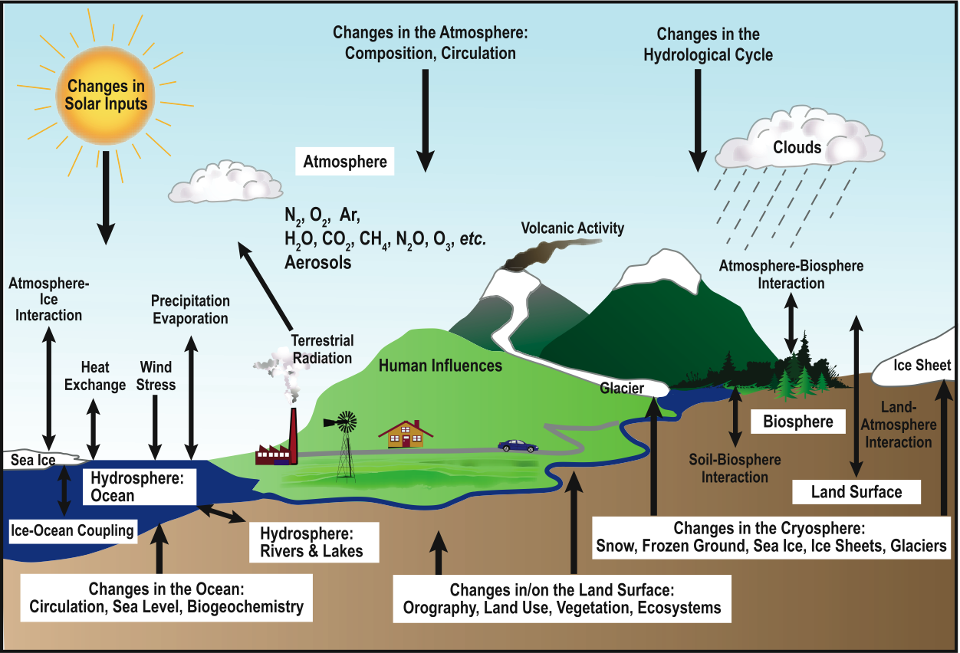
Green Energy and Climate Modeling
Climate or weather
The Climate System

Slide 4
Question 1: What is Climate?
Average/Expected ‘Weather’
The temperature & precipitation range
Distribution of all possible weather
Record of Extreme events

Slide 5
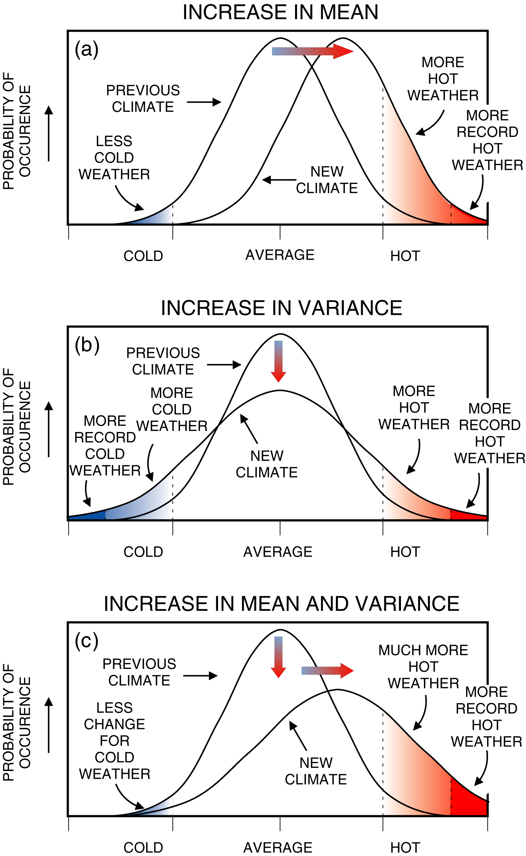
Climate change
and its manifestation
in terms of weather
(climate extremes)
(1) What is Climate?

Slide 6
Climate change
and its manifestation
in terms of weather
(climate extremes)

Slide 7
Climate change
and its manifestation
in terms of weather
(climate extremes)

Slide 8
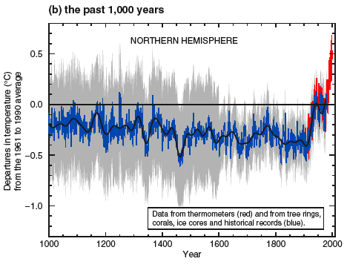
Observed Temperature Records
IPCC, 3rd Assessment, Summary For Policymakers

Slide 9
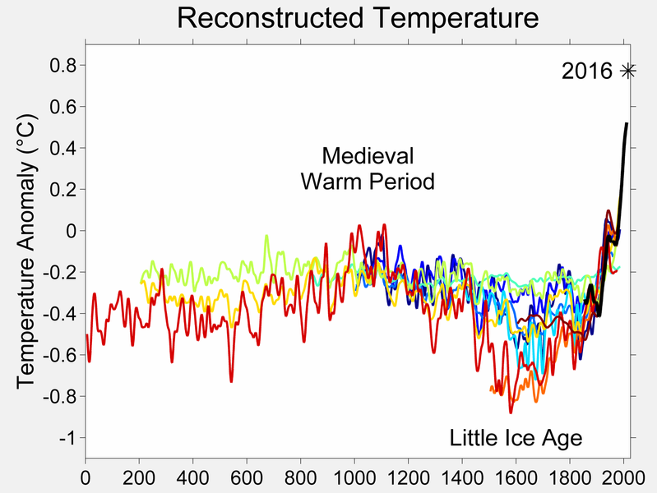

Slide 10
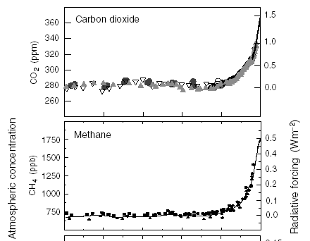
‘Anthropogenic’ Changes
Radiative Forcing (Wm⁻²)
1000 1200 1400 1600 1800 2000

Slide 11
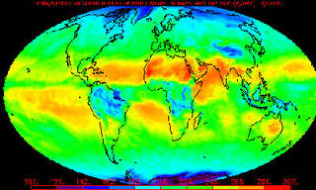
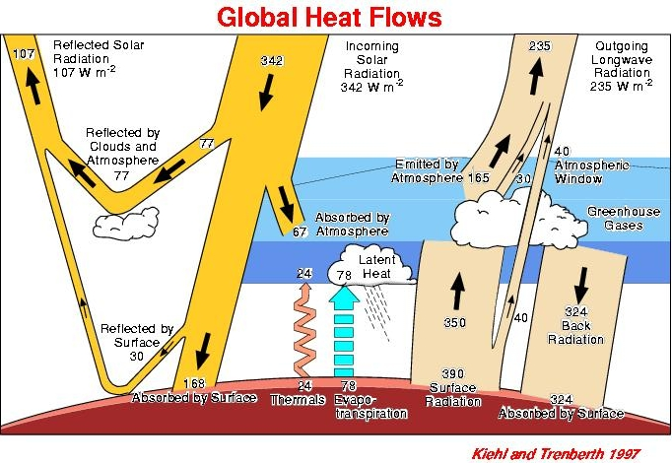
Why temperature is increasing???
Temperature measurement of the earth
Energy balance of the earth
Radiation

Slide 12
Why temperature is increasing???
Temperature measurement of the earth
Energy balance of the earth: Energy inflow from sun to earth and out flow from earth to space
Energy loss from the earth depends on earth temperature
Hotter earth loses heat faster than cooler one
Earth balances its energy by warming up or cooling down finding the temp at which inflow=outflow
Increase in outgoing energy with increase temp of earth results in a feedback which stabilizes the temp of earth at the temp at which inflow=outflow

Slide 13
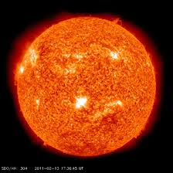
Change in Average temp (inflow=outflow)
How to change average temp???
By reducing incoming flow or increase out going flow
Changing sun brightness: sunspot
Or ……. Sun light reflecting back to space
Clouds, snow, bare soil, smoke
Or ……. Increase Outflow of energy from earth to space

Slide 14
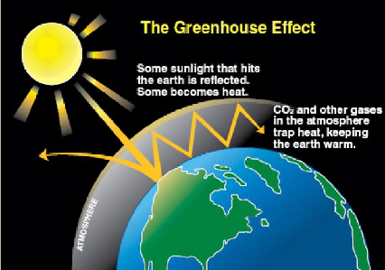
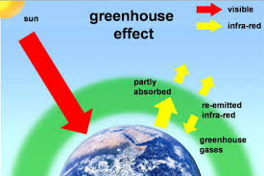
Problem in Increase Outflow of energy from earth to space
Green house gases:
Co₂
Water vapor
Methane/hydro carbon/nitrous
Smoke
w/o naturally occuring green house effect av temp :
-18
w/o green house effect av temp ???
15 ⁰C
Energy sources????
Feedback mechanism leads to higher temperature stabilization

Slide 15
78% nitrogen
20.6% oxygen
< 1% argon
0.4% water vapor
0.036% carbon dioxide
traces gases:
Ne, He, Kr, H, O₃
Methane, Nitrous Oxide

Slide 16
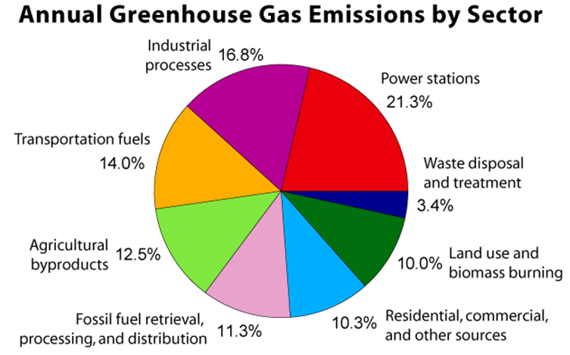
2007 Greenhouse Gas Emissions by Gas (percents based on Tg CO2 Eq.) (Tg – teragram = 10¹² g) (http://www.epa.gov/climatechange/emissions/downloads09/ExecutiveSummary.pdf )

Slide 17
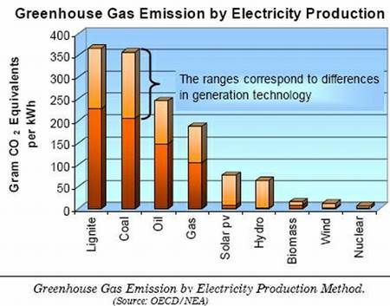

Slide 18
Problem with green house gases:
Absorption Spectra of Atmospheric Gases
Visible
UV
Infrared
CH₄
N₂O
O₂ & O₃
CO₂
H₂O
atmosphere
WAVELENGTH (micrometers)
Anthes, p. 55

Slide 19
Selected Greenhouse Gases
Carbon Dioxide (CO₂)
Source: Fossil fuel burning, deforestation
Anthropogenic increase: 30%
Average atmospheric residence time: 500 years
Methane (CH₄)
Source: Rice cultivation, cattle & sheep ranching, decay from landfills, mining
Anthropogenic increase: 145%
Average atmospheric residence time: 7-10 years
Nitrous oxide (N₂O)
Source: Industry and agriculture (fertilizers)
Anthropogenic increase: 15%
Average atmospheric residence time: 140-190 years

Slide 20
Summary
Greenhouse gases absorb infrared radiation and prevent it from escaping to space.
Carbon dioxide, methane, and nitrous oxide are very good at capturing energy at wavelengths that other compounds miss
The “greenhouse effect” & global warming are not the same thing.
Global warming refers to a rise in the temperature of the surface of the earth
An increase in the concentration of greenhouse gases leads to an increase in the magnitude of the greenhouse effect. (Called enhanced greenhouse effect)
This results in global warming

Slide 21
Atmospheric Feedbacks
Increased CO₂
POSITIVE
NEGATIVE
Increased CO₂
More water vapor & other changes
+
Higher temperature
+
Increased cloud cover
More water vapor
More reflected solar radiation
–
More absorbed infrared radiation
Lower temperature
+
+
Higher temperature
Less water vapor
+
More water vapor

Slide 22
Global Warming, A Quick Poll
Is global warming real?
Yes
No
How much has the average temperature of the Earth risen in the last 100 years?
~ 0.5°C
~ 1.0°C
~ 5.0°C
~ 10.0°C
Who is to blame?
Human activities
Nature causes
ET
NoCanTell!
What is to blame?
Ozone
CO₂
H₂O
O₂

Slide 23
Global Warming, A Quick Poll
Is global warming real?
Yes
No
How much has the average temperature of the Earth risen in the last 100 years?
~ 0.5°C
~ 1.0°C
~ 5.0°C
~ 10.0°C
Who is to blame?
Human activities
Nature causes
ET
NoCanTell!
What is to blame?
Ozone
CO₂
H₂O
O₂
NoCanTell. It is real complicated!

Slide 24
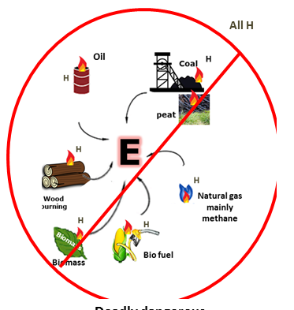
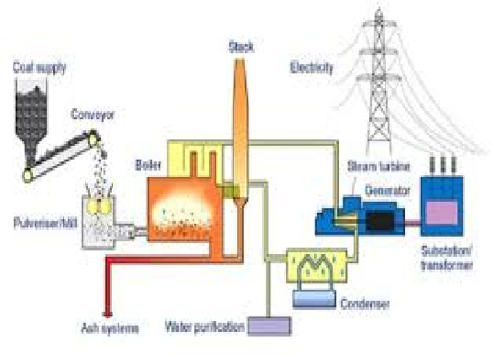
Energy sources????
Carbon……..energy……climate
Fossil fuel:
formed by natural processes such as decomposition of buried dead organisms, containing energy originating in ancient photosynthesis. high % carbon in petroleum, coal, and natural gas

Slide 25
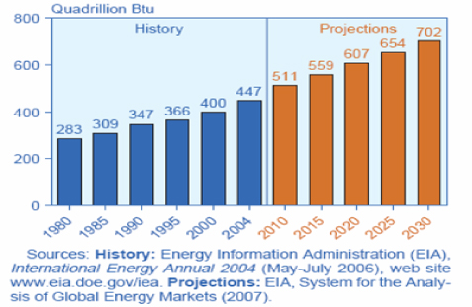
Energy:

Slide 26
Energy Reserves We do not know exact values; I will quote estimates¹ in terms of J of electricity How long they will last is even more uncertain; to give an order of magnitude I will use current total World consumption of ~ 5×10²⁰ J year⁻¹
¹ David MacKay “Sustainable Energy – without the hot air” www.withouthotair.com

Slide 27
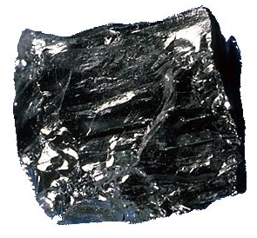
Energy Reserves:
Coal+oil&gas
4.7×10²² J
94 years
¹ David MacKay “Sustainable Energy – without the hot air” www.withouthotair.com

Slide 28
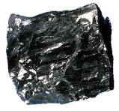
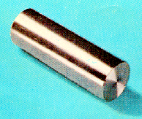
Energy Reserves:
Coal+Oil&Gas
4.7×10²² J
94 years
Uranium Ore
2.6×10²³ J
520 years
[Fast breeder]

Slide 29

Energy Reserves:
Coal+Oil%Gas
4.7×10²² J
94 years
U 0.0033 ppm
Uranium Ore
2.6×10²³ J
520 years
Uranium in Seawater
3.3×10²⁴ J
6600 years

Slide 30
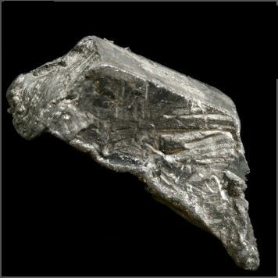

Energy Reserves:
Coal+Oil%Gas
4.7×10²² J
94 years
Uranium Ore
2.6×10²³ J
520 years
Lithium Ore
7.9×10²² J
160 years
U 0.0033 ppm
Uranium in Seawater
3.3×10²⁴ J
6600 years

Slide 31

Energy Reserves:
Coal+Oil%Gas
4.7×10²² J
94 years
Lithium Ore
7.9×10²² J
160 years
Li 0.17 ppm
Uranium Ore
2.6×10²³ J
520 years
Lithium in Seawater
8.3×10²⁶ J
1.7×10⁶ years
U 0.0033 ppm
Uranium in Seawater
3.3×10²⁴ J
6600 years

Slide 32
Energy Reserves:
Coal+Oil%Gas
4.7×10²² J
94 years
Lithium Ore
7.9×10²² J
160 years
D 0.035 ppm
Uranium Ore
2.6×10²³ J
520 years
Li 0.17 ppm
DD Fusion
2.4×10³⁰ J
4.8×10⁹ years
U 0.0033 ppm
Lithium in Seawater
8.3×10²⁶ J
1.7×10⁶ years
Uranium in Seawater
3.3×10²⁴ J
6600 years
Sizes relative to energy reserves on a log scale

Slide 33
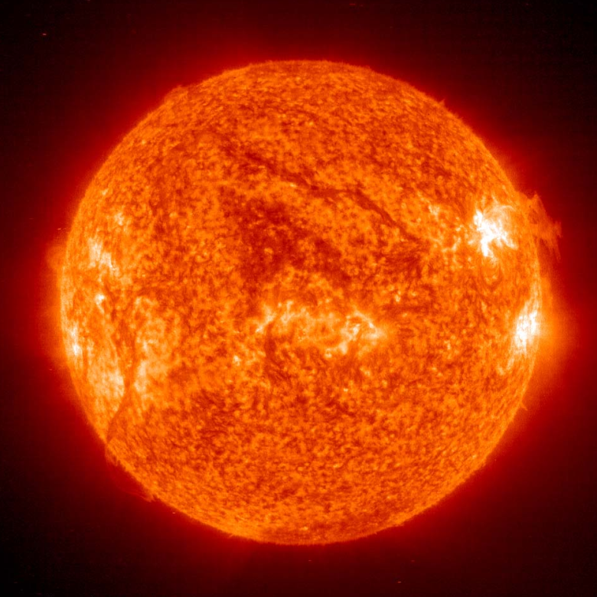
Energy Reserves:
Coal+Oil%Gas
4.7×10²² J
94 years
Lithium Ore
7.9×10²² J
160 years
Uranium Ore
2.6×10²³ J
520 years
Li 0.17 ppm
The Sun
5×10⁹ years
U 0.0033 ppm
Lithium in Seawater
8.3×10²⁶ J
1.7×10⁶ years
Uranium in Seawater
3.3×10²⁴ J
6600 years
Sizes relative to energy reserves on a log scale

Slide 34
1.1.1 Energy Source Categories
Non renewable
Renewable
Conventional
Alternative
080805
Notes:
Renewables face economic challenges.

Slide 35
1.1.1 Energy Source Categories
Non renewable
Renewable
Conventional
Coal
Oil
Gas
Nuclear Fission
Alternative
080805
Notes:
Renewables face economic challenges.

Slide 36
1.1.2 Energy Source Categories
Non renewable
Renewable
Conventional
Coal
Oil
Gas
Nuclear Fission
Wood
Hydro
Human/Animal
Wind Water Pumping
Alternative
080805
Notes:
Renewables face economic challenges.

Slide 37
1.1.3 Energy Source Categories
Non renewable
Renewable
Conventional
Coal
Oil
Gas
Nuclear Fission
Wood
Hydro
Human/Animal
Wind Water Pumping
Alternative
Geothermal
Oil Shale, CTL
Tar Sands
Methane Hydrates
080805
Notes:
Renewables face economic challenges.

Slide 38
1.1.4 Energy Source Categories
 | Non renewable | Renewable
Conventional | Coal Oil Gas Nuclear Fission | Wood Hydro Human/Animal Wind Water Pumping
Alternative | Geothermal Oil Shale, CTL Tar Sands Methane Hydrates | Wind Solar Biomass Wave/Tide Ocean Current
Sustainable means using less than is renewed; if water is withdrawn from a dam faster than it is refilled, the level drops and hydro power is lessened, and finally fails
080820
Notes:
Renewables face economic challenges.

Slide 39
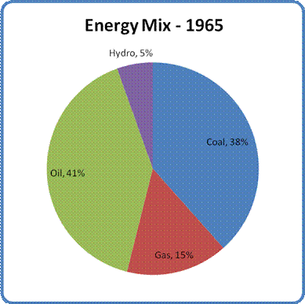
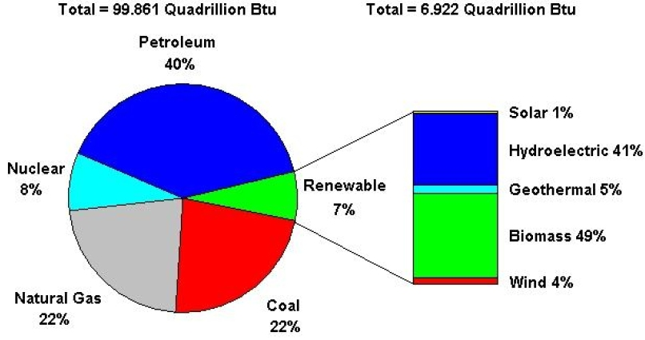
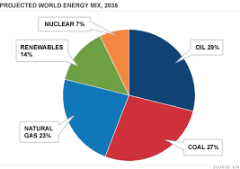
2010
http://www.eia.doe.gov/cneaf/solar.renewables/page/trends/highlight1.html

Slide 40
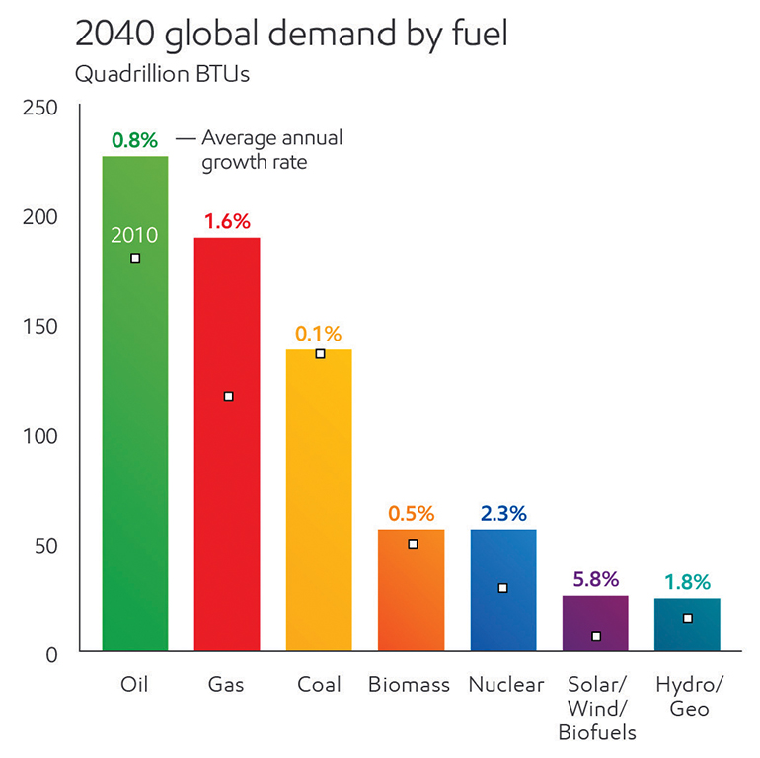
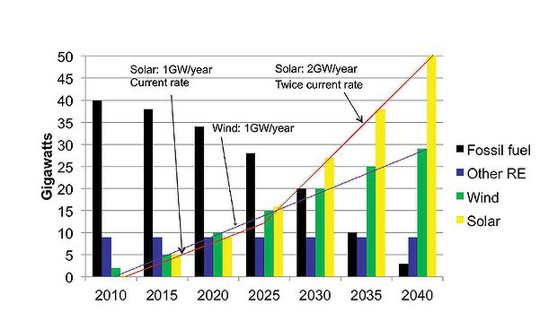
Solar Energy…
The Sun
Australia

Slide 41
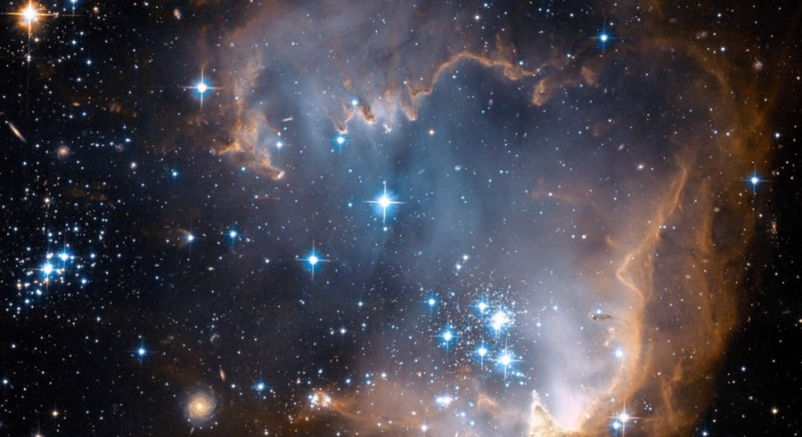
Controlled Nuclear Fusion
When atoms fuse, energy is released. This is the process that powers the Sun.
Fusion is the energy source of the Universe, occuring in the core of the Sun and stars.

Slide 42
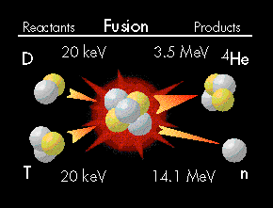
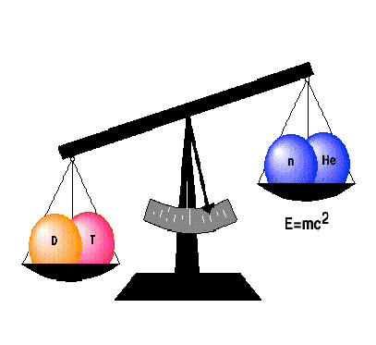
Fusion Energy
Nuclei are positively charged so they repel each other.
Energy has to be input to overcome this repulsive force
The sun and stars derive their energy from fusion.
F
F
+
+
For the past 50 years, scientists have been working on the development of fusion technologies to generate energy on earth.

Slide 43
How can we capture the potential of fusion energy?
A fuel at 10⁸ K cannot be contained in a furnace as in conventional thermo-electric power stations
All materials are plasmas (ionized gas) at this temperature
Two alternatives
Contain the fuel in a magnetic field
Charged particles move in circles around magnetic field lines
Magnetic confinement fusion (MCF), magnetic fusion energy (MFE), or magnetic fusion
Let the fuel expand freely in the centre of a chamber
Inertial confinement fusion (ICF), inertial fusion energy (IFE) or inertial fusion

Slide 44
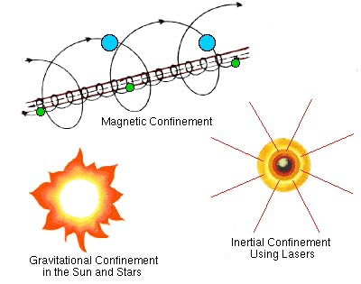
Methods for Confinement

Slide 45
Methods for Confinement
A fuel at 10⁸ K cannot be contained in a furnace as in conventional thermo-electric power stations
All materials are plasmas (ionized gas) at this temperature

Slide 46
Methods for Confinement
There are only three approaches to confining these hot plasmas:
Gravitational confinement: Because of their large masses, the sun and other stars are able to hold hot gases together. Hot plasmas are confined with gravitational fields in Sun and Stars.
Magnetic confinement: Magnetic fields are used to “bottle up” the hot electrically charged gas atoms (under continuous study worldwide for the last 30 years).
Inertial confinement: In laser fusion, DT mixtures are compressed and heated very quickly, so that the fusion reactions are completed before the gases can fly apart.
In fusion energy experiments magnetic fields are used to confine hot plasma, and inertial
confinement uses lasers.
High temperature and high particle density for long period of time are the conditions for fusion.
Magnetic and inertia confinements keep particle density high.

Slide 47
Two major approaches to fusion (D–T)
Magnetic confinement
Inertial confinement

Slide 48
Two major approaches to fusion (D–T)
Magnetic confinement
Temperature ≈ 10 ⁸ °C (10 keV)
nτ ≈ 10 ¹⁵ atoms ·seconds / cm ³
τ ≈ 10 seconds (magnetic “bottle”)
n ≈ 10 ¹⁴ atoms / cm ³ (10 –5 times the density of air)
Inertial confinement
Temperature ≈ 10 ⁸ °C (10 keV)
nτ ≈ 10 ¹⁵ Atoms ·seconds / cm ³
τ ≈ 3 × 10 ^{–11} seconds (micro explosion, inertial “bottle”)
n ≈ 3 × 10 ²⁵ Atoms / cm ³ (12 times the density of lead!
~ 1000 times the density of liquid DT!)

Slide 49
Fusion energy requires
Three parameters control the fusion reaction rate.
Heating the plasma up to more than 100 million degrees
The plasma pressure (P); the reaction rate is approximately proportional to P².
The ‘energy confinement time’ (τ_{E}) defined by
energy in plasma
τ_{E} =
power supplied to heat plasma
.
where τ_{E} measures how well the magnetic field insulates the plasma. It is obvious that the larger τ_{E}, the more effective a fusion reactor will be as a net source of power.
A measure of plasma performance is thus given by:
n_{DT}T_{i} τ_{E}
density * temperature * confinement

Slide 50
Magnetic confinement fusion
Efforts to control fusion first relied on the principle of magnetic confinement, in which a powerful magnetic field traps a hot deuterium-tritium plasma long enough for fusion to begin.
In magnetic confinement fusion (MCF), the fuel (deuterium and tritium) is heated to a temperature which is ten times that at the centre of the Sun. The energy confinement time is maximized. The hot plasma is confined by strong magnetic fields leading to maximum densities of about 1.5 x 10²⁰/m³, which is 2 x 10⁵ times smaller than the atom density of a gas under normal conditions. With these densities, the energy confinement time required is in the range of 2-4 seconds.
Tokamak configuration is used to the confinement of plasma.
The tokamak is a toroidally shaped device characterised by a hollow vessel or chamber, forming the “doughnut”, in which the plasma is confined by a magnetic field and bound to force field lines along a spiralling path.
Tokamak Fusion Test Reactor (TFTR) project has been successfully completed, and a large international Project has under development the ITER (International Thermonuclear Experimental Reactor) to further develop magnetic confinement fusion with the goal of energy production.

Slide 51
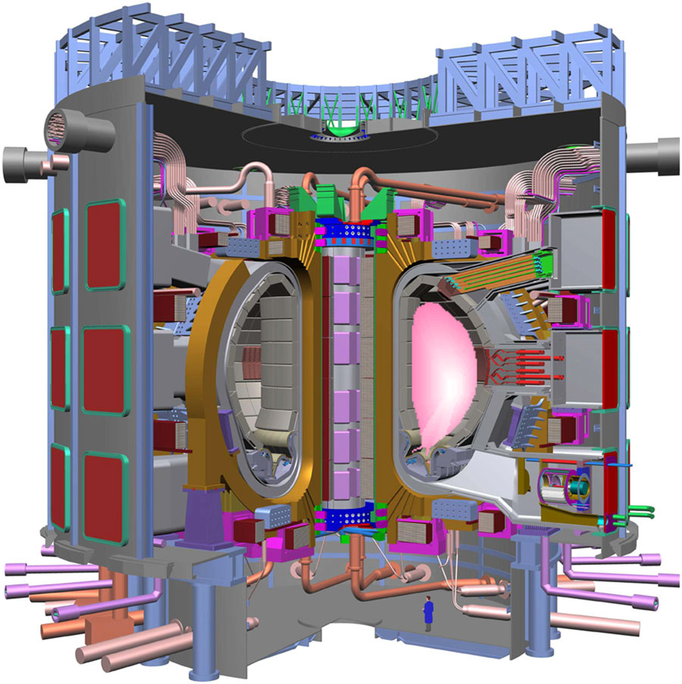
ITER: The first fusion reactor
The International Thermonuclear Experimental Reactor (ITER) to be built in France and is a collaboration between US, Europe, Japan, India, China, Russia, and Korea.
ITER is being built on the principle of tokamak based magnetic confinement fusion.
To achieve fusion, the temperature levels inside the ITER machine will rise to 150 million degrees Celsius.
ITER hopes to produce 500 Megawatts of
electricity for approximately 1000 secondsby the fusion of 0.5 grams of a deuterium/tritium mixture.
plasma current ~15 Meg Amps, magnetic field ~5 Tesla/SC,
temperature ~ 100 million Kelvin, density ~ 10¹⁴ m ⁻³

Slide 52
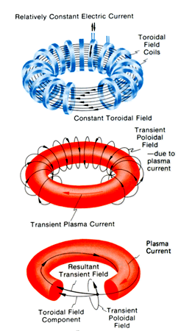
ITER a tokamak to demonstrate energy gain is being built in France (start operations in 2019)
www.iter.org

Slide 53
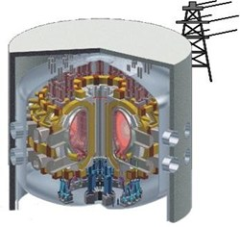
The Step After That…
DEMO a prototype power station
Generating 2 – 4 GW in the 2040s?

Slide 54
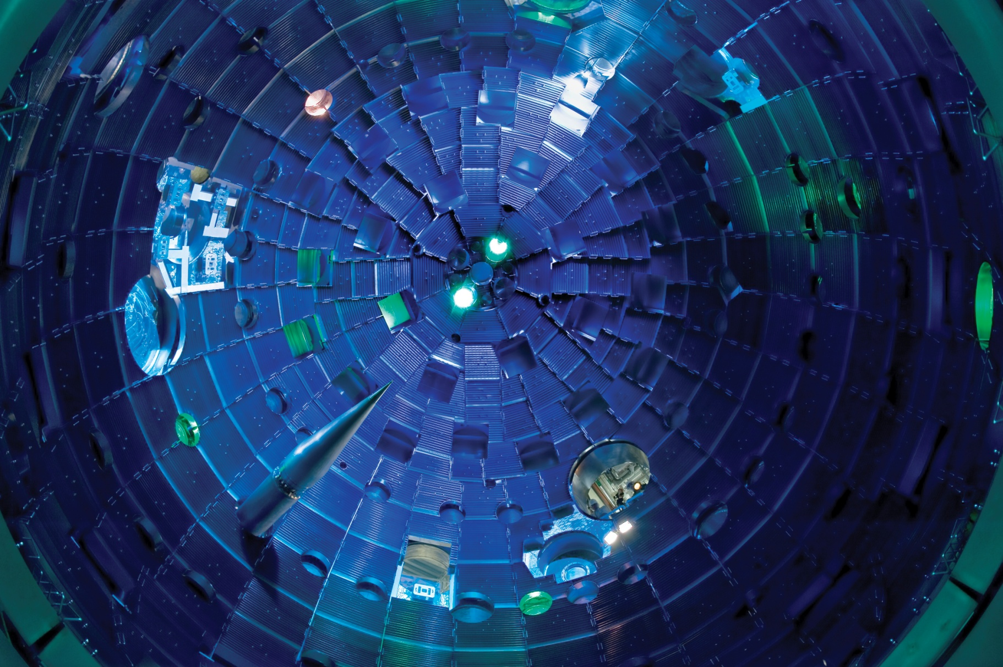
Inertial Fusion
NIF Lawrence Livermore National Laboratory

Slide 55
Plasma Conditions During ICF
Before compression and ignition Density: solid DT pallet at 0.225 g/cm³ and gas Temperature: few Kelvin
During the burn phase Density: 300 to 1000 times solid density 300 to 1000 g/cm³ ≈ 10²⁶ cm⁻³ Temperature: around 10.000.000 K or 10 keV Pressure: around 10¹² bar
Confinement time needed: around 200 ps

Slide 56
The Concept
Inertial Fusion relies on extracting fusion energy from a freely expanding plasma in a series of micro-explosions
There is no confinement, but by analogy with magnetic (confinement) fusion the “confinement” time is determined by inertia
After this time cooling due to expansion will lead to a rapid drop in the fusion reaction rate

Slide 57
Requirements
Assuming constant density and temperature during the confinement time and no reactions afterwards the burn fraction at 10 keV (kT/e, 10⁸ K) is given by:
Numerical modelling gives a burn parameter of 7 g cm⁻² provided that ρR > 1.5 g cm⁻², below this f falls rapidly
A containable yield requires a mass < 10 mg therefore ρR > 6 g cm⁻² requires ρ > 300 g cm⁻³
1000 times solid density (atoms m⁻³)
The need for such astronomical densities is the major challenge of inertial fusion

Slide 58
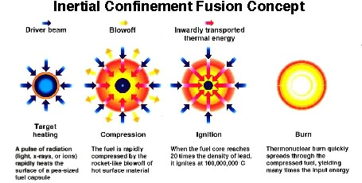
Achieving High Densities
A hollow sphere ~ mm in diameter is compressed by heating the outside to produce an expanding plasma that acts like a rocket propelling the shell inwards
The inside must remain degenerate in order to minimize the pressure (~ 790 eV at 300 g cm⁻³ giving ~ 30 Gbar)
Compression time ~ 10⁻⁸ s
Minimum absorbed energy ~ 100 kJ

Slide 59
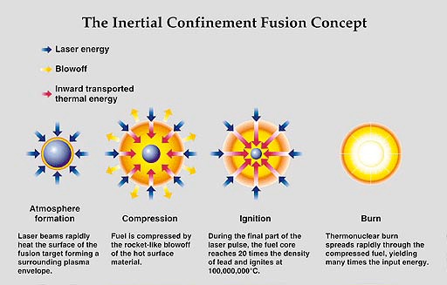
Controlling Fusion using Inertia

Slide 60
Achieving High Temperatures
If the implosion velocity exceeds 10⁵ m s⁻¹ then the collision of the walls at the centre leads to temperatures sufficient to start fusion reactions and the alpha particles heat the rest of the plasma

Slide 61


Inertial Confinement Fusion
Direct Drive:
Laser Beams are focused onto the
surface of the target ( pellet of fuel)
Indirect Drive
Laser Beams are focused at the
inner site of the cylinder
NATIONAL IGNITION FACILITY
HiPER
Laser Beam
cylindrical hohlraum made of gold
Target
Target, filled with a deuterium tritium (D-T) mixture
In this approach, multiple laser beams with a 20 ns duration precisely shaped pulse are arranged in cones about the axis of a high-Z cylindrical hohlraum.
A hohlraum is a hollow, cylinder-shaped device that is used to focus and control radiation.

Slide 62
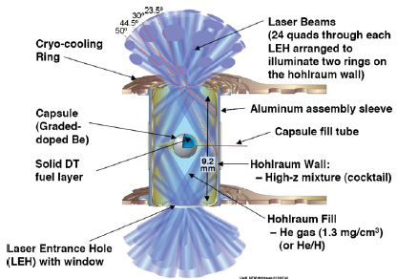
National Ignition Facility in the US
In 2013 NIF put 1 MJ of laser energy into a 10 mm Au/U cylinder (hohlraum) producing X-rays that will crush a 2 mm diameter Be sphere lined with DT ice emitting 20 MJ in fusion products
Indirect drive
https://lasers.llnl.gov

Slide 63
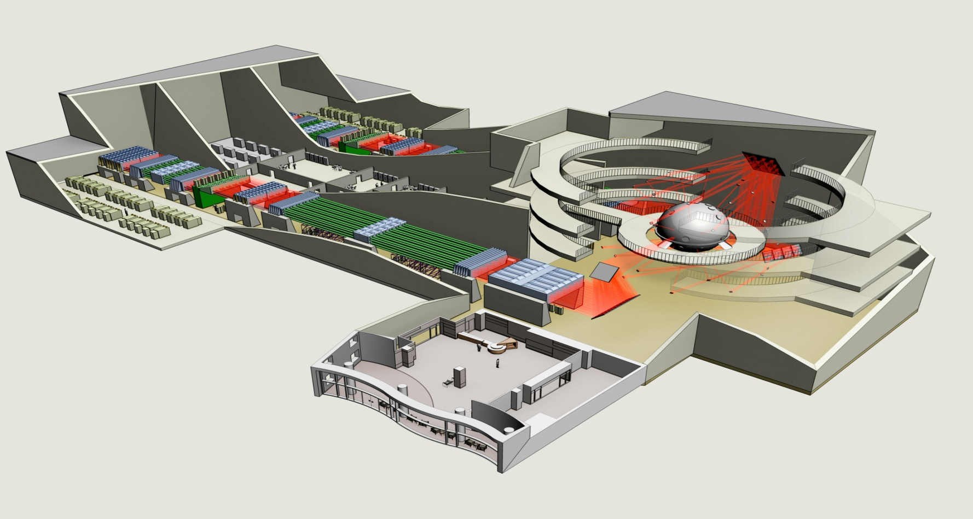
HiPER European Fusion Energy Research Project by 2020
40 beamlines of about 5 kJ each to generate a total of 200 kJ for compression
whereas the ignition side requires 24 beamlines of just under 3 kJ to generate a total of 70 kJ

Slide 64
Laser Plasma Interaction: Extreme Physics
Plasma
DT Target
Laser

Slide 65
ADVANTAGES OF CONTROLLED FUSION
Clean energy source that produces no greenhouse gases.
Limitless amount of fuel available, deuterium and tritium easy to produce.
Fusion, unlike fission, does not involve a chain reaction, so the process can be stopped eliminating the risk of a meltdown.
Fusion does not produce nuclear waste, only the core of the reactor remains radioactive and only for 100 years.
Fusion has the potential to fuel the entire world for relatively low costs
compared to today’s fuels.

Slide 66
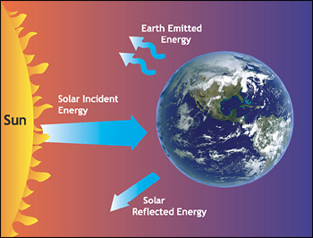
radiations

Slide 67
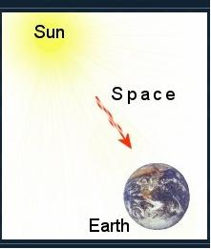
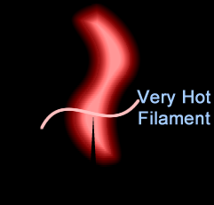
Radiation
All matter having temperature higher than absolute zero emits energy in the form of thermal radiation
Rate of emission depends on the surface, nature and temperature of body
At the same time it receive (absorb) radiations from surrounding.
According to Maxwell, transfer of heat or thermal energy through radiation is propagated from one to another position without intervening the medium or space just like light energy propagates
As an electromagnetic wave, thermal radiation follow:
In free space have speed of light
Follow straight line path
reflection, refraction, interference, diffraction, polarization

Slide 68
Radiation and physical objects
Any physical material (solid, liquid, gas) interacts with
electromagnetic waves (radiation) in one of four different ways.
TRANSMISSION: waves pass through the material
ABSORPTION: some of the waves are absorbed (& heat)
REFLECTION: some of the waves are reflected in the direction
they came from.
EMISSION: Every object (above absolute zero) emits radiation
because it possesses thermal energy
Less important:-
SCATTERING: waves are deflected (hence blue sky…)

Slide 69
A key fact for Earth’s climate is that gases in the atmosphere absorb radiation.
Molecules absorb radiation at particular wavelengths, depending on amount of energy required to cause vibration or rotation of atomic bond.
Two essential things for the greenhouse effect:
The Earth’s atmosphere is mostly transparent to visible radiation (why not totally)
The Earth’s atmosphere is mostly opaque to infrared radiation.
Notes:
You are all familiar with this because you know that in a microwave oven, only water molecules vibrate in response to microwaves. Most of the molecules in the food you are trying to heat are two large to respond to this particular wavelength of light.
Size of molecules….
or excitation of electrons.
O₃ absorbs radiation near 10 μm
CO₂ absorbs radiation near 15 μm

Slide 70
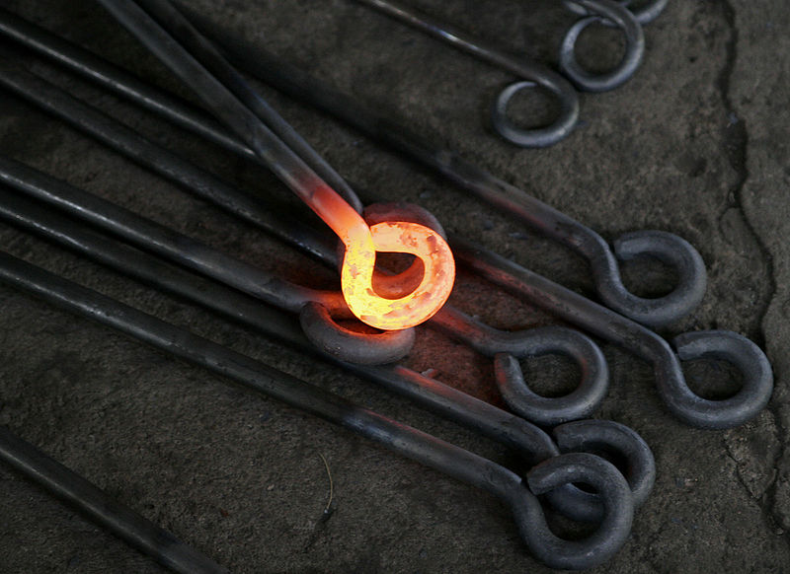
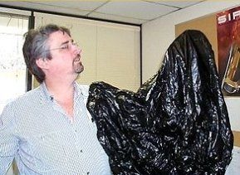
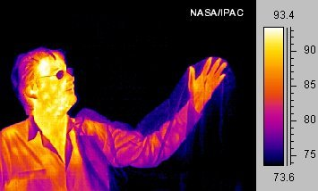
Much of a person's energy is radiated away in the form of infrared light. Some materials are transparent in the infrared, while opaque to visible light, as is the plastic bag in this infrared image. Other materials are transparent to visible light, while opaque or reflective in the infrared, noticeable by darkness of the man's glasses

Slide 71
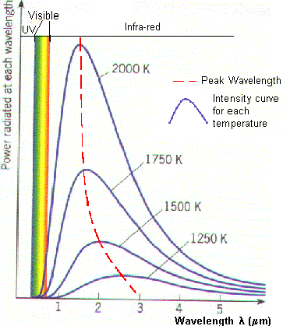
Radiation

Slide 72
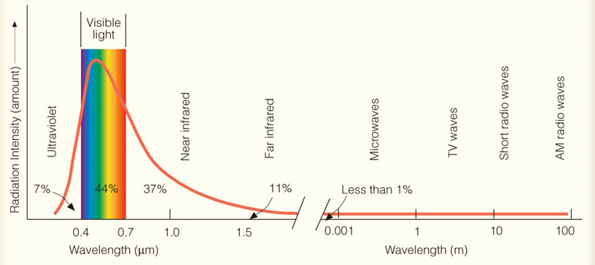
Radiation

Slide 73
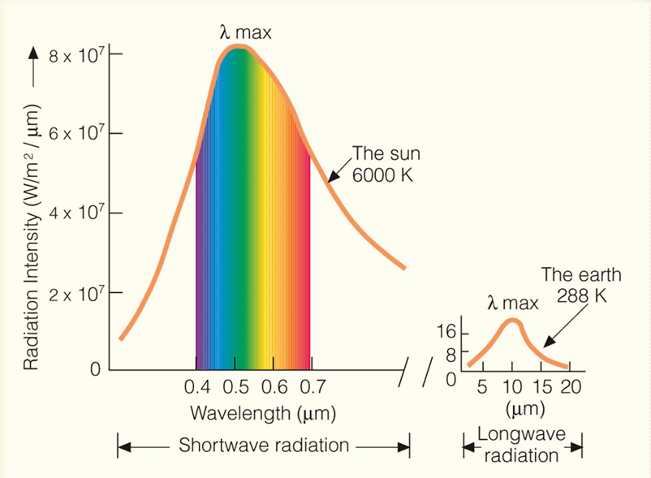
Blackbody radiation curves typical for the Sun and Earth

Slide 74
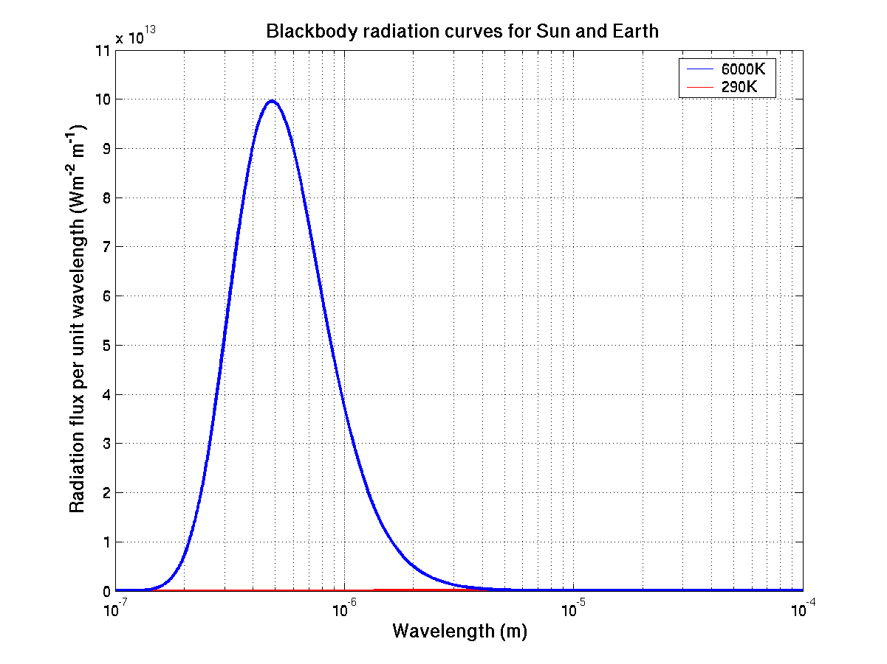
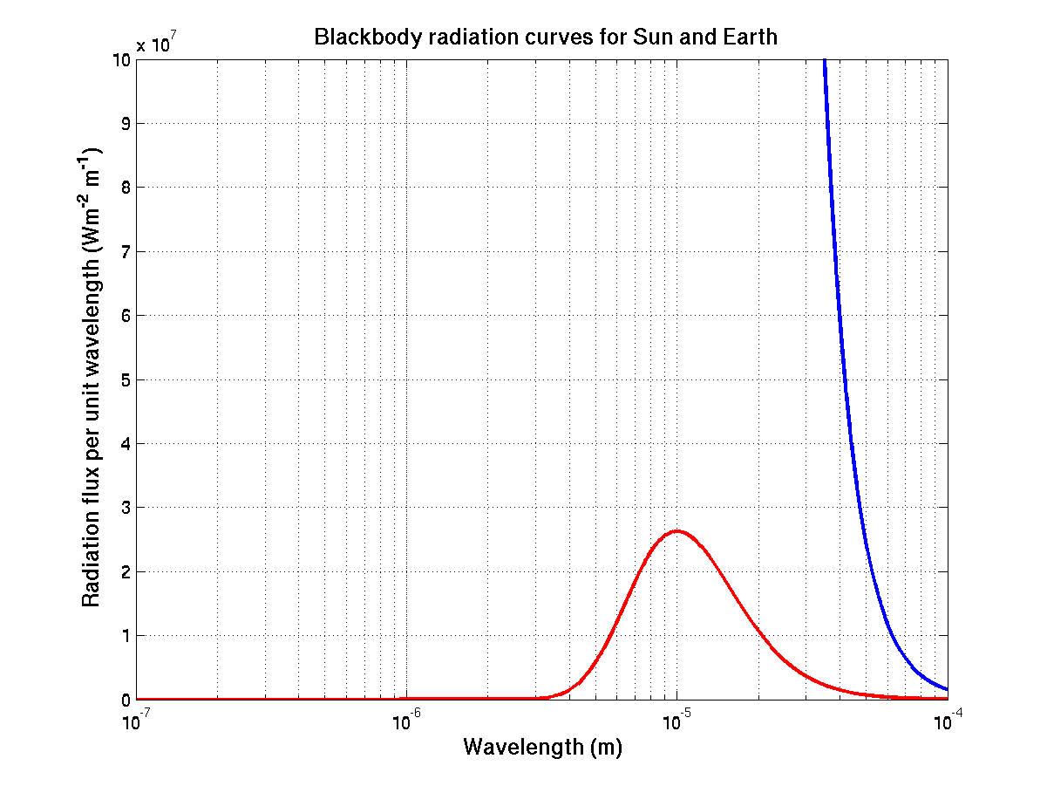
Blackbody radiation curves typical for the Sun and Earth
Sun ~6000K
Earth ~290K
Sun radiates a lot more energy that the Earth!

Slide 75
Radiation
Useful definitions:
total energy density (u): total radiant energy per unit volume for all wavelength radiating at any point
spectral energy density (u_{λ}): energy per unit volume for a range of λ
total emissive power (E): radiant energy per unit time per unit surface area of body for all wavelength
spectral emissive power (e_{λ}): radiant energy per unit time per unit surface area at particular wavelength
absorptive power (a_{λ}): ratio of absorbed energy to total energy at particular termp and wavelength
relative emittance (e): ratio of emittance by a surface to emittance of black body. e = E’/E

Slide 76

Black Body Radiation
A body that absorbs all radiation incident upon it, regardless of frequency, is called a blackbody.
Ability of a body to radiate is closely related to its ability to absorb radiation.
As it is a perfect absorber, it is also perfect radiator.
As blackbody absorbs all the radiations and doesn’t reflector transmitted any, it appears black

Slide 77
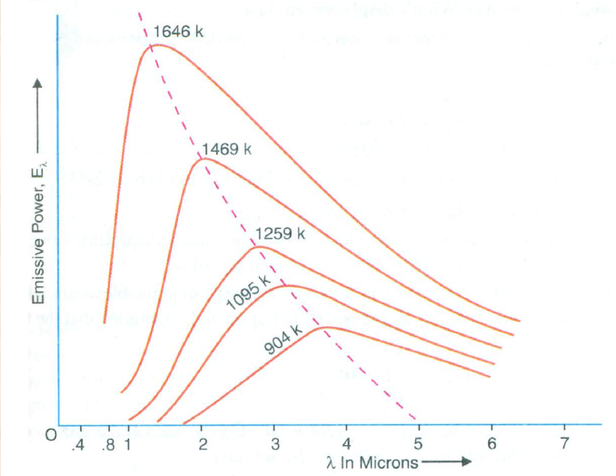
Black Body Radiation Curves
At a given temperature (T), the energy is not uniformly distributed in the radiation spectrum of a black body.
At a given T, the intensity of heat radiation increases with ↑ in λ and at a particular λ its value is maximum i.e. λ_{m}. With further ↑ in λ, the intensity of heat radiation ↓.
An ↑ in T causes a ↓ in λ_{m}, such that λ_{m}T=constt. This is called Wein’s displacement law.
An ↑ in T causes an ↑ in the energy emission, for all wavelentgh.
(v) The area under each curve represents the total energy emitted by the body at a particular temperature for the range of λs considered. This area ↑s with ↑ in temperature of the body. It is found that the area is directly proportional to the fourth power of the temperature of the body, i.e. , E∝ T⁴ , this represents Stefan-Boltzmann’s law.

Slide 78
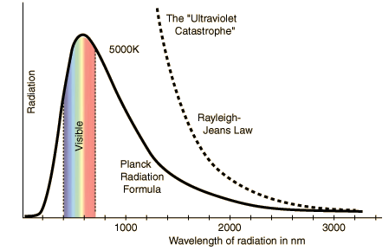
The black body radiation curve shows that
The black body does radiate energy at every wavelength. Energy of the radiation initially increases, reaching at a maxima (peak wavelength) then decreases but never goes to zero.
At 5000K the peak wavelength is about (500nm or 0.5 μm) which is in the visible light region. (Example : Sun)
At each temperature the black body emits a standard amount of energy. This is represented by the area under the curve. (Stefan’s Law) E∝ T⁴
As the temperature increases, the peak wavelength emitted by the black body decreases. (Wien’s displacement law)
It therefore begins to move from the infra-red towards the visible part of the spectrum.
Fig 1: Black body radiation curve for 5000K. Peak wavelength is 500nm.
Fig 2: Black body radiation curves showing peak wavelengths (Red line) at various temperatures

Slide 79


Rayleigh-Jeans Law: First Attempt to explain Radiation
curve behavior.
Rayleigh and Jeans considered the radiation inside the black body (cavity) to be a series of standing electromagnetic waves, on the assumption that the em wave radiation spectrum emitted by a black body continuously vary in wavelengths from zero to infinity
The number of standing waves per unit volume (density of em standing waves or allowed modes or density of states) is
This equation is independent of shape of the cavity. λ is wavelength, v is frequency and c is speed of light.

Slide 80
Planck’s Quantum Postulates
A black body radiation chamber is filled up not only with radiation, but also with simple harmonic oscillators or resonators (energy emitters) of the molecular dimensions, known as Planck's oscillators or Planck's resonators, which can vibrate, with all possible frequencies. The vibration of the resonator entails one degree of freedom only.
The oscillators (or resonators) cannot radiate or absorb energy continuously, but energy is emitted or absorbed in the form of packets or quanta called photons. the theory states that the exchange of energy between radiation and matter cannot take place continuously but only in certain multiples of the fundamental frequency of the resonator (energy emitter).
As the energy of a photon is hv, the energy emitted (or absorbed) is equal to 0, hv, 2hv, 3hv, ..........nhv, i.e., in multiplets of some small unit, called as quantum.
Notes:
A black body radiation chamber is filled up not only with radiation, but also with simple harmonic oscillators or resonators (energy emitters) of the molecular dimensions, known as Planck's oscillators or Planck's resonators, which can vibrate, with all possible frequencies. The vibration of the resonator entails one degree of freedom only.
The oscillators (or resonators) cannot radiate or absorb energy continuously, but energy is emitted or absorbed in the form of packets or quanta called photons. Planck assumed that each photon has an energy hv where h is the Planck's constant, its value being equal to 6.625 × 10⁻³⁴ Joule-sec, and v is the frequency of radiation. This assumption is the most revolutionary in character. In other words, the theory states that the exchange of energy between radiation and matter cannot take place continuously but only in certain multiples of the fundamental frequency of the resonator (energy emitter).As the energy of a photon is hv, the energy emitted (or absorbed) is equal to 0, hv, 2hv, 3hv, ..........nhv, i.e., in multiplets of some small unit, called as quantum.

Slide 81

Max Planck:
blackbody radiation is produced by vibrating submicroscopic electric charges, which he called resonators the walls of a cavity are composed of resonators vibrating at different frequency.
Classical Maxwell theory:
An oscillator of frequency ν could have any value of energy and could change its amplitude continuously by radiating any fraction of its energy
Planck: the total energy of a resonator with frequency ν could only be an integer multiple of hν. (During emission or absorption of light) resonator can change its energy only by the quantum of energy ΔE=hν
E=nhν where n 1,2,3,...
ΔE=hν
4hν
3hν
2hν
hν
0

Slide 82



E_{n}=nhν
N_{n}
Total Energy (E) = N_{o}E_{o}+N₁E₁+N₂E₂+N₃E₃…+N_{n}E_{n}
Total number of resonators (N)=N_{o}+N₁+N₂+N₃…+N_{n}
E₃=3hν
N₃
E₂=2hν
N₂
N₁
E₁=hν
E_{o}=0
N_{o}
Therefore average energy(ε)=Σ E_{n}/Σ N_{n}

Slide 83

Average energy of Planck's oscillator:
According to Maxwell's law of molecular motion,
If N_{o} → number of resonators having energy zero, then the number of resonators N₁ having energy E₁ will be
N_{o} e^{-hν/kT} , similarly for N₂ = N_{o}e^{-2hν/kT} and N_{n} = N_{o} e^{-nhν/kT} .
The total energy of Plank’s resonator will be
∴ av. Energy of a resonator will be

Slide 84
Therefore, the energy density belonging to the range dv can be obtained by multiplying the average energy of Planck's oscillator by the number of oscillators per unit volume, in this frequency range ν and (ν + dv).
where u(ν)dν is energy density (i.e., total energy per unit volume) belonging to the range dv called Planck's radiation law in terms of frequency.

Slide 85





Wien’s displacement law
The wavelength whose energy density is greatest can be obtained by setting
and solving for λ = λ_{max}. We find
Which may be written as
This equation is known as Wien’s displacement law. It quantitatively expresses the empirical fact that the peak in the black body spectrum shifts progressively to shorter wavelength (higher frequencies) as the temperature is increased.

Slide 86
Wien’s Displacement Law
Hot objects (stars) emit radiation that peaks at relatively short wavelength
The blackbody temperature is 6000K
For the Sun it is about 0.5μm
Cold objects (planets, like the Earth-atmosphere system) emit peak radiation at longer wavelengths
The blackbody temperature is 288K (15ºC)
For the Earth it is about 10μm

Slide 87
Stefan-Boltzmann Law
Total energy density within the cavity can be obtained by integrating energy density (eq. 3) over all frequencies. Thus
Here a is a universal constant. According to the equation, the total energy density is proportional to the fourth power of the absolute temperature of the cavity walls. Therefore we expect that energy E radiated by a black body per second per unit area is also proportional to T⁴ i.e.
Where, e = emissivity, ranges from 0 (for perfectly reflecting surface) to 1 (for a black body, and σ (Stefan’s constant) = ac/4 =5.67x10⁻⁸ watt/m²-K⁴.
This equation is known as Stefan-Boltzmann Law.

Slide 88
Q1: An x-ray photon is scattered by an electron. The frequency of the scattered photon relative to that of the incident photon (a) increases, (b) decreases, or (c) remains the same.
Quest:
Ans: (b)
Q2. A photon of energy E₀ strikes a free electron. The scattered photon with energy E moves in opposite direction that of the incident photon. In this Compton effect interaction, the resulting kinetic energy of the electron is (a) E₀ , (b) E , (c) E₀ − E , (d) E₀ + E , (e) none of the above.
Ans: (c)
Q3. Deduce the expression for the maximum kinetic energy of the recoiled electron.
Q4. Why Compton effect not observed with visible light.
Q5. Explain the presence of unmodified scattered radiation along with modified radiations for non zero scattering angle.

Slide 90




Thanks For Your Attention

